Slide 1
Hi guys
Open your working files from last week
If you lost your files or your files are horribly broken and want to start fresh, you can start off from where I left off:
https://chesnot.moe/start_2.zip
Start at 7:10 as usual, let everyone come back from playing nerf guns and eating ice cream at MPH
Let’s aim to finish our simple webapp tonight!
Last Session Today T_T

Slide 2
3DC Web Dev Series
Part 4 – Javascript, the Developer Tools, and the Meaning of Life (?)

Slide 3
A note on syntax;
Unlike python, code blocks in control structures are demarcated with parentheses (curly braces);
You must end each statement with a semicolon;
if (1 == 1){
alert(“Math is working!”);
}
if 1 == 1 :
print(“Math is working!”)
Javascript
Python
Braces
semicolon
Indentation is actually not interpreted by the computer, but to help you to visualise the code blocks;

Slide 4
Escape characters
Note that “ or ‘ is used to mark your string literals. What if you want to literally enter a “ character?
var abc = “And then he said, \”Hello World! \” “;
Other escape characters include \n for a newline and \t for a tab space.

Slide 5
My code doesn’t work!!!
How to debug your code when it doesn’t run
Syntax Highlighting lets you spot these syntax mistakes in your code
(Good) code editors will usually inform you that you missed a semicolon or a bracket, (but you should not wait for your editor to tell you something is wrong!)
If you discover your webpage doesn’t run as expected, you can open the Developer Tools.

Slide 6
Developer Tools
F12
Command
+
Option
+
I
Windows
Mac

Slide 7
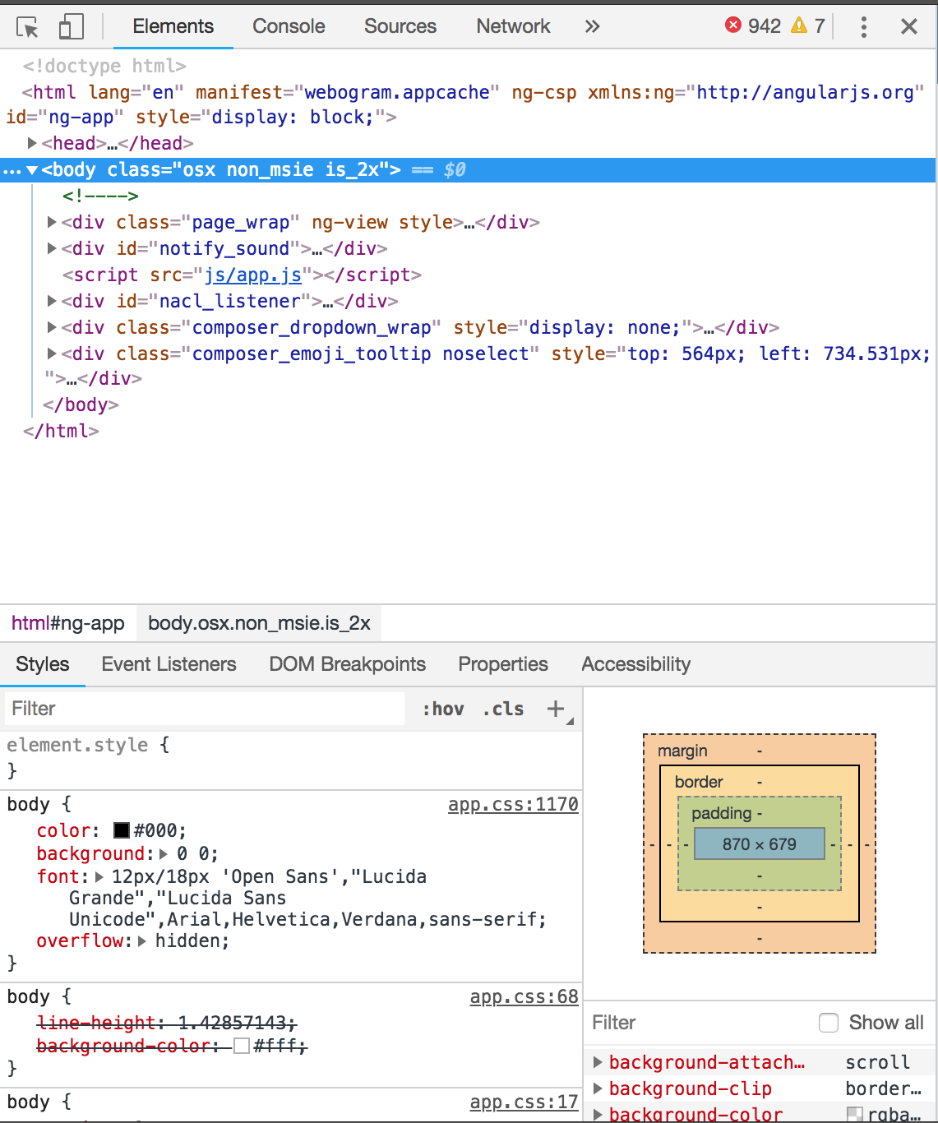
Developer Tools
Magic!!!!

Slide 8
Developer Tools – Element Inspector
Shows the HTML document your browser retrieved from the server
Allows you to inspect an element’s values, attributes and styles; it also lets you change them for testing purposes

Slide 9
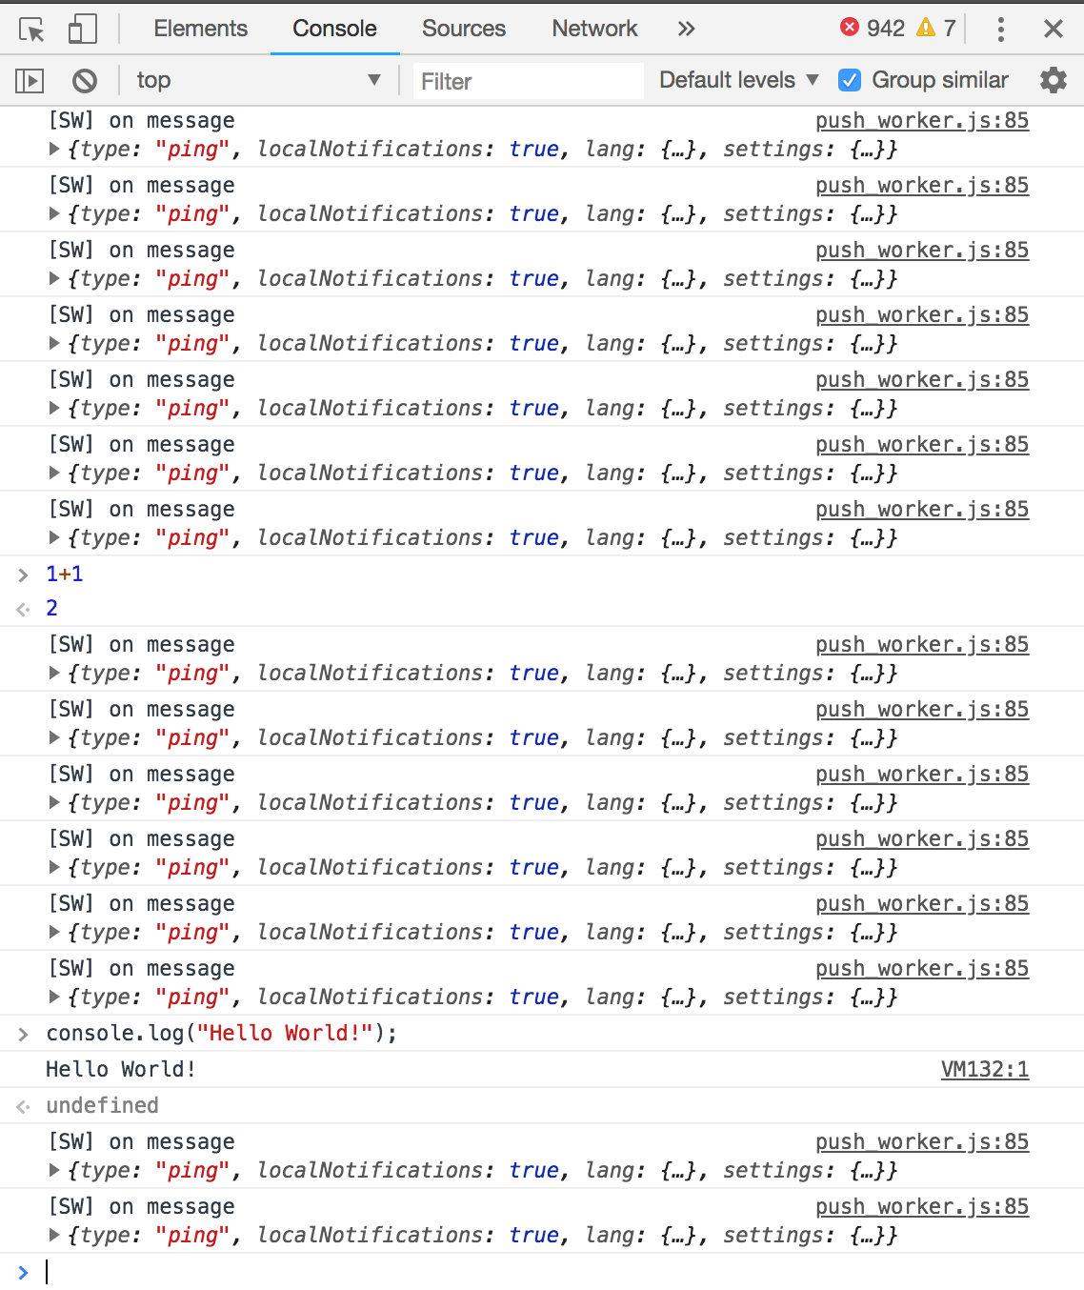
Developer Tools – Javascript Console
Let’s you execute any JavaScript you enter, then returns the result to you
Log calls from console.log shows up here
Prints any errors your script encounters

Slide 10
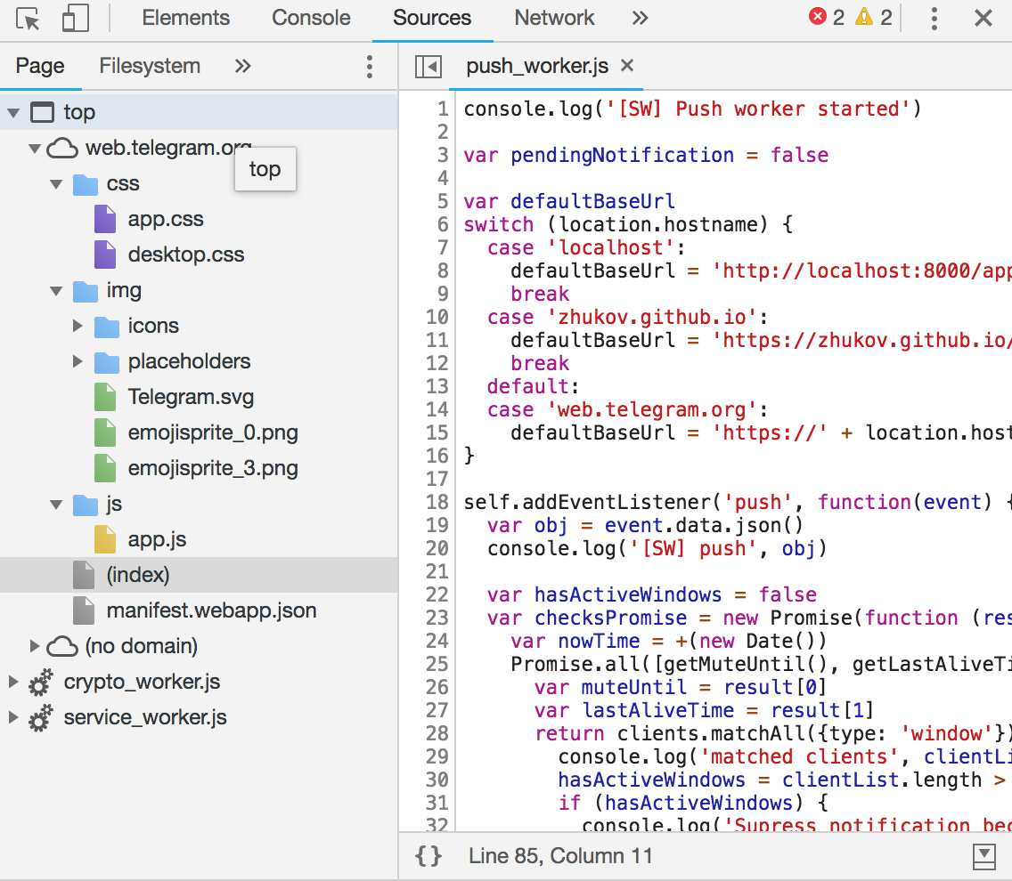
Developer Tools - Sources
Shows you what other files have been downloaded and kept by the browser in order to show the page, like Windows Explorer
External JS and CSS files, as well as images, will show up here in a tree-like directory structure
Lets you inspect the source code of the external CSS and JS files, and also edit them temporarily for testing purposes

Slide 11
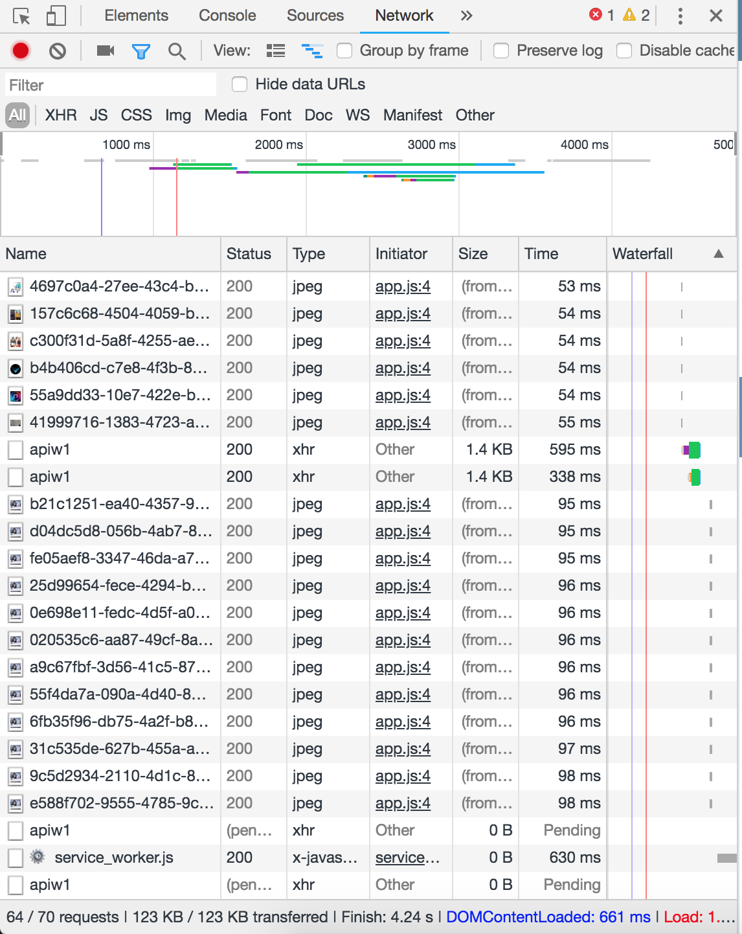
Developer Tools – Network Log
Lets you see what other HTTP requests your browser makes in order to load the page
CSS files, JS files, image files, XHR/AJAX requests…
Shows you how long it takes for them to load

Slide 12

Back to Javascript - Arrays
MDN Reference - Arrays
Arrays are another data type in Javascript that act as containers for data.
An array can contain multiple types of data at once.
var places = [”Canteen”, “Classroom”, “Lecture Hall”];

Slide 13
Array Access
MDN Reference - Arrays
An individual element in an array can be accessed with the [ ] operator.
var places = [”Canteen”, “Classroom”, “Lecture Hall”];
console.log(places[0]);
//returns “Canteen”
Note: array indices start at zero
Note: be careful not to give an index that is longer that the length of the array itself, or you will get a runtime error (out-of-bounds)

Slide 14


Array push, pop
MDN Reference – Push, pop
You can add and remove elements with the following methods:
var places = [”Canteen”, “Classroom”, “Lecture Hall”];
places.push(“Hostel”);
console.log(places);
//returns [“Canteen”, “Classroom”, “Lecture Hall”, “Hostel”]
places,pop();
console.log(places);
//returns [“Canteen”, “Classroom”, “Lecture Hall”];
Note: pop and push will always operate at the last position of the array.

Slide 15

Array splice
MDN Reference - Splice
Lets you remove and insert at any position in the array
var alphabet = [“A”, “B”, “D”, ”E”];
alphabet.splice(2,0,”C”);
console.log(alphabet);
//returns [“A”, “B”, “C”, “D”, “E”];
alphabet.splice(2,3,”X”);
console.log(alphabet);
//returns [“A”, “B”, “X”];
Object to insert after deletion
Position to start removing from
Number of elements to remove

Slide 16

Array length
MDN reference - length
The .length property gives you the length of the array.
You can combine this with the array accessor to access elements while counting from the end of the array
var alphabet = [ “A”, “B”, “C”, “D”, …… , “X”, “Y”, “Z”];
console.log(alphabet[alphabet.length - 1]);
//returns “Z”;
console.log(alphabet[alphabet.length - 2]);
//returns “Y”;
Note: Be careful not to give a negative number as your array index as it will cause a runtime error (out of bounds)

Slide 17
Iterating through Arrays - Loops
Iterating through arrays (“scrolling through” every element of the array) can be achieved with a type of control structure – loops
Loops will execute the actions in its block until a certain condition is satisfied

Slide 18

For Loop
MDN Reference - Loops
A for loop lets you initialise a ”counter” variable, then proceeds to run the following code until the specified condition is no longer true

Slide 19
For Loop
MDN Reference - Loops
Initialisation
Run Condition
End Change
for(var i = 0; i < 5; i++){
console.log(“I have run “ + i + “times”);
}
Your “End Change” statement must make the counter variable move closer to the target condition, or your loop will run forever!
// “I have run 0 times”
// “I have run 1 times”
// “I have run 2 times”
// “I have run 3 times”
// “I have run 4 times”

Slide 20
Iterating through Arrays
Using this behaviour of for loops, you can use them to iterate through arrays.
var places = [”Canteen”, “Classroom”, “Lecture Hall”, “Hostel”];
for(var i = 0; i < places.length; i++){
console.log(“I have been to the “ + places[i]);
}
// “I have been to the Canteen”
// “I have been to the Classroom”
// “I have been to the Lecture Hall”
// “I have been to the Hostel”

Slide 21
While loop
MDN Reference - Loops
Another loop directive, but difference being it only takes one condition statement (no counter variables, no “end of loop” action)
Not really used in web applications. Use this when you have no specific estimate of how many times you want your loop to run.
As with for loops, beware of infinite loops.
while(someCondition == true){
console.log(“I will run forevaaaaaaaaa”);
}

Slide 22

Objects
MDN Reference - Objects
Objects are the generic data type in JavaScript and they be made to represent anything.
You can add your own properties and methods to your objects.

Slide 23
Objects
MDN Reference - Objects
Objects are constructed in a similar way to arrays, but a few differences:
Use curly brackets instead of square brackets
Data is stored in alphanumeric key-value pairs, instead of numeric indices
Properties and Methods like .length and .push() are not available (unless you define your own)
Access data with dot notation instead of using the [ ] operator
var myComputer = { brand : “apple” , year : 2015 , model : “Macbook Pro” };
key
value
key
value
key
value
console.log(myComputer.brand);
//returns “apple”

Slide 24
Objects and Arrays
You can combine objects and arrays!
var computers = [
{
brand: “Apple”,
year: 2015,
model: “Macbook Pro”
},
{
brand: “Asus”,
year: 2017,
model: “ROG something”
}
];
Array element 0 – object
Object contains three properties, brand year model
Opening array brackets
Array element 1 – another object
Object also contains three properties, brand year model
An array of objects
console.log(computers[1].model);
//returns “ROG something”

Slide 25
Objects and Arrays
You can go deeper – arrays of objects in objects!
var me = {
name: “Doot Doot”,
age: 20,
friends: [{
name : “Cat”,
age : 19
},
{
name : “Dog”,
age: 21
}],
occupation: “NEET”
};
console.log(me.friends[1].name)
//returns “Dog”
We’re going to represent the list of all the places in SUTD as an array of objects in our SUTD Map!

Slide 26
Importing JS files
Like CSS files, you can move your JS to external JS files to separate your code cleanly.
Separating the files also lets you reuse your code across multiple pages.
<script src="js/place_data.js"></script>

Slide 27
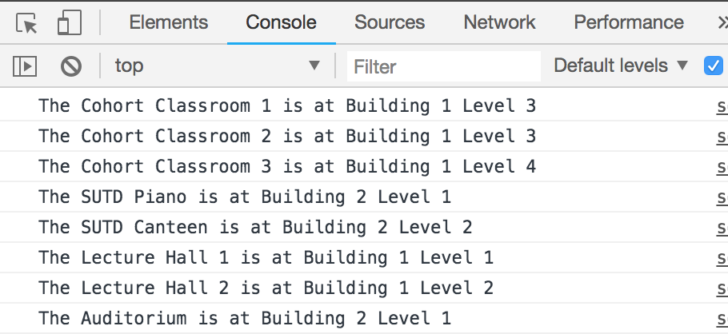
Exercise – 20min
After you have imported the JS file, you should have a variable named places available to use in your code. (Make sure your import is before your main code).
Using loops, array accessors and dot notation for objects, can you loop through the places variable and print a statement like this in the console for each place listed?

Slide 28

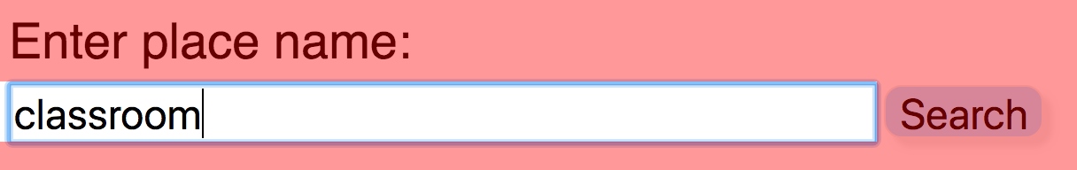
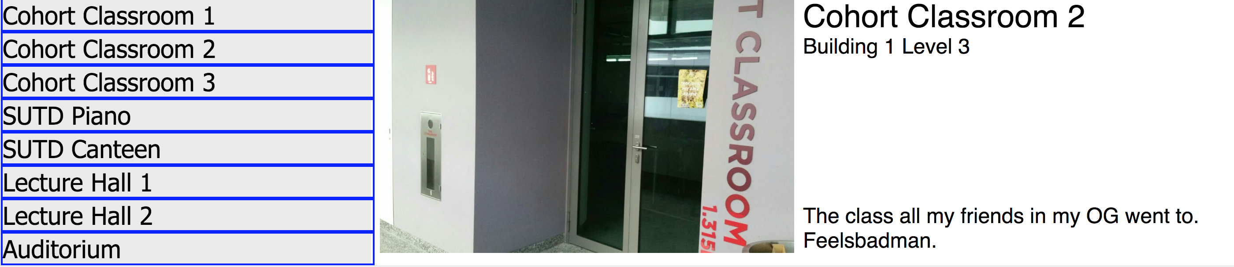
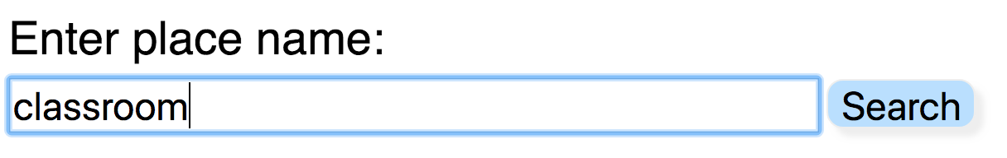
Activity Cycle of a Simple Webapp
Javascript analyses the state of the current document
e.g. retrieve the search term in the box
Javascript processes the inputs and produces suitable output
DOM Manipulation
Event fired
(click)
Wait for
Search button is pressed
next event
Javascript presents the output by creating new elements or modifying existing elements

Slide 29

Modifying Elements in the DOM
MDN Reference - findElementById
Recap: Elements can be accessed in JavaScript by their id attribute using the function
document.findElementById(“your-element-id”)

Slide 30

.innerHTML
MDN Reference - innerHTML
Element objects have a .innerHTML property that lets you read or modify the direct HTML code of what’s inside the element.
<h1 id=“title”>SUTD Map</h1>
<div id=“result-list”>
<p> Place 1 </p>
<p> Place 2 </p>
<p> Place 3 </p>
</div>
console.log(document.getElementById(“title”).innerHTML);
//returns SUTD Map
console.log(document.getElementById(“result-list”).innerHTML);
// returns <p> Place 1 </p>
<p> Place 2 </p>
<p> Place 3 </p>

Slide 31
.innerHTML
MDN Reference - innerHTML
Since .innerHTML is innately a string, you can simply add/remove elements on the page by manipulating this string.
<h1 id=“title”>SUTD Map</h1>
<div id=“result-list”>
<p> Place 1 </p>
<p> Place 2 </p>
<p> Place 3 </p>
</div>
document.getElementById(“result-list”).innerHTML += “<p> Place 4 </p>”;
You can empty the contents of an element simply by setting its .innerHTML to an empty string.

Slide 32
The object-orientated way
Adding elements directly with .innerHTML will get messy pretty quick.
An alternative is to use JavaScript objects to represent the elements you are going to add.

Slide 33

createElement
MDN Reference – document.createElement
document.createElement() will give you an object representation of an element that you can later use to add to an existing element on the page.
Pass the tag name of the new element as the argument
var newP = document.createElement(“p”);

Slide 34

appendChild
MDN reference - appendChild
After setting the contents of the new element to be created with .innerHTML , you can then use the appendChild() method to add the new element object inside the selected parent element.
var newP = document.createElement(“p”);
newP.innerHTML = “New awesome place”;
document.getElementById(“result-list”).appendChild(newP);

Slide 35

setAttribute
MDN reference - setAttribute
In conjunction with .innerHTML, the setAttribute() function can be used to set the attributes of any element in object form.
var newImg = document.createElement(“img”);
newImg.setAttribute(“src”,”img/cat.jpg”);
document.getElementById(“result-list”).appendChild(newImg);
document.getElementById(“some-other-img”).setAttribute(“src”,”img/dog.jpg”);

